Slide 1
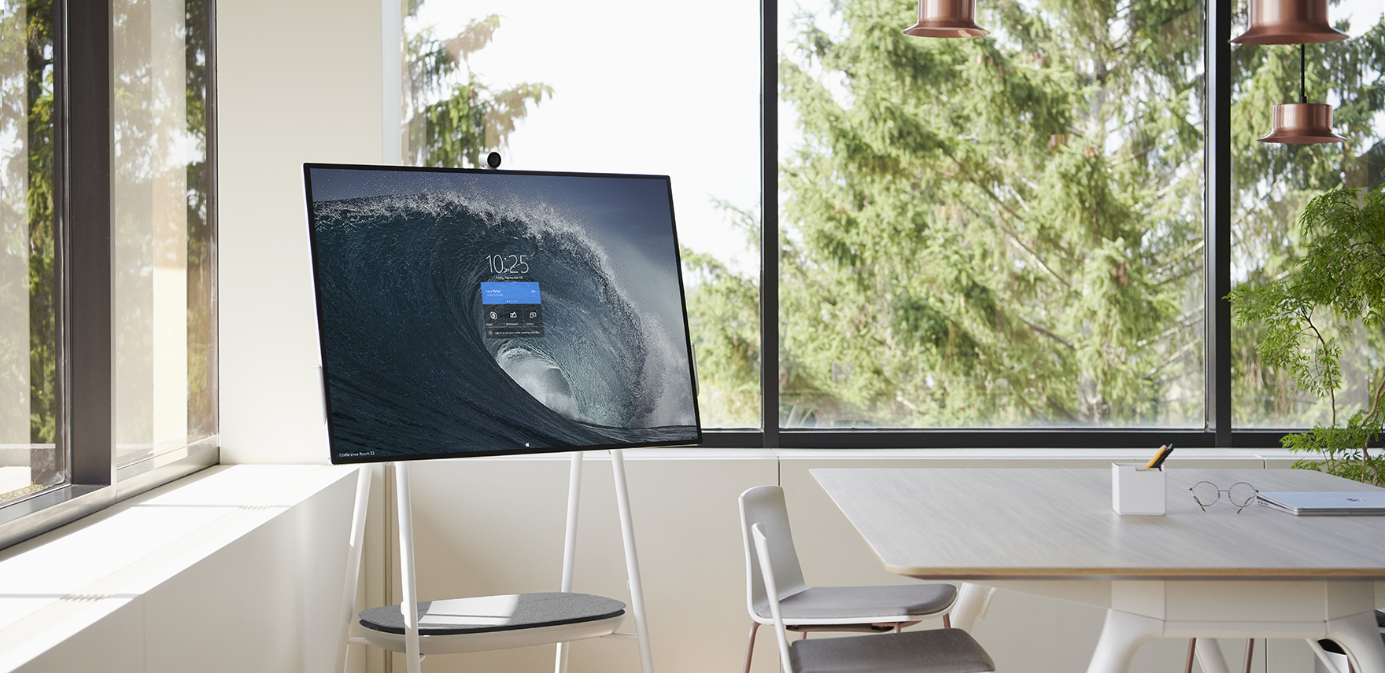
Surface Hub 2S Navigation Guide

Slide 2
Table of contents
Welcome screen – Where every session starts
Start menu – Launch apps, sign in, access your files
App workspace – Multitasking with apps
Full screen – Switch in and out of full screen
Clip to the whiteboard – Capture the screen to the whiteboard
Task view – Switch and close apps
End session – Close out a session and return to Welcome screen
More options and notifications – Change volume, Do not disturb, Restart

Slide 3
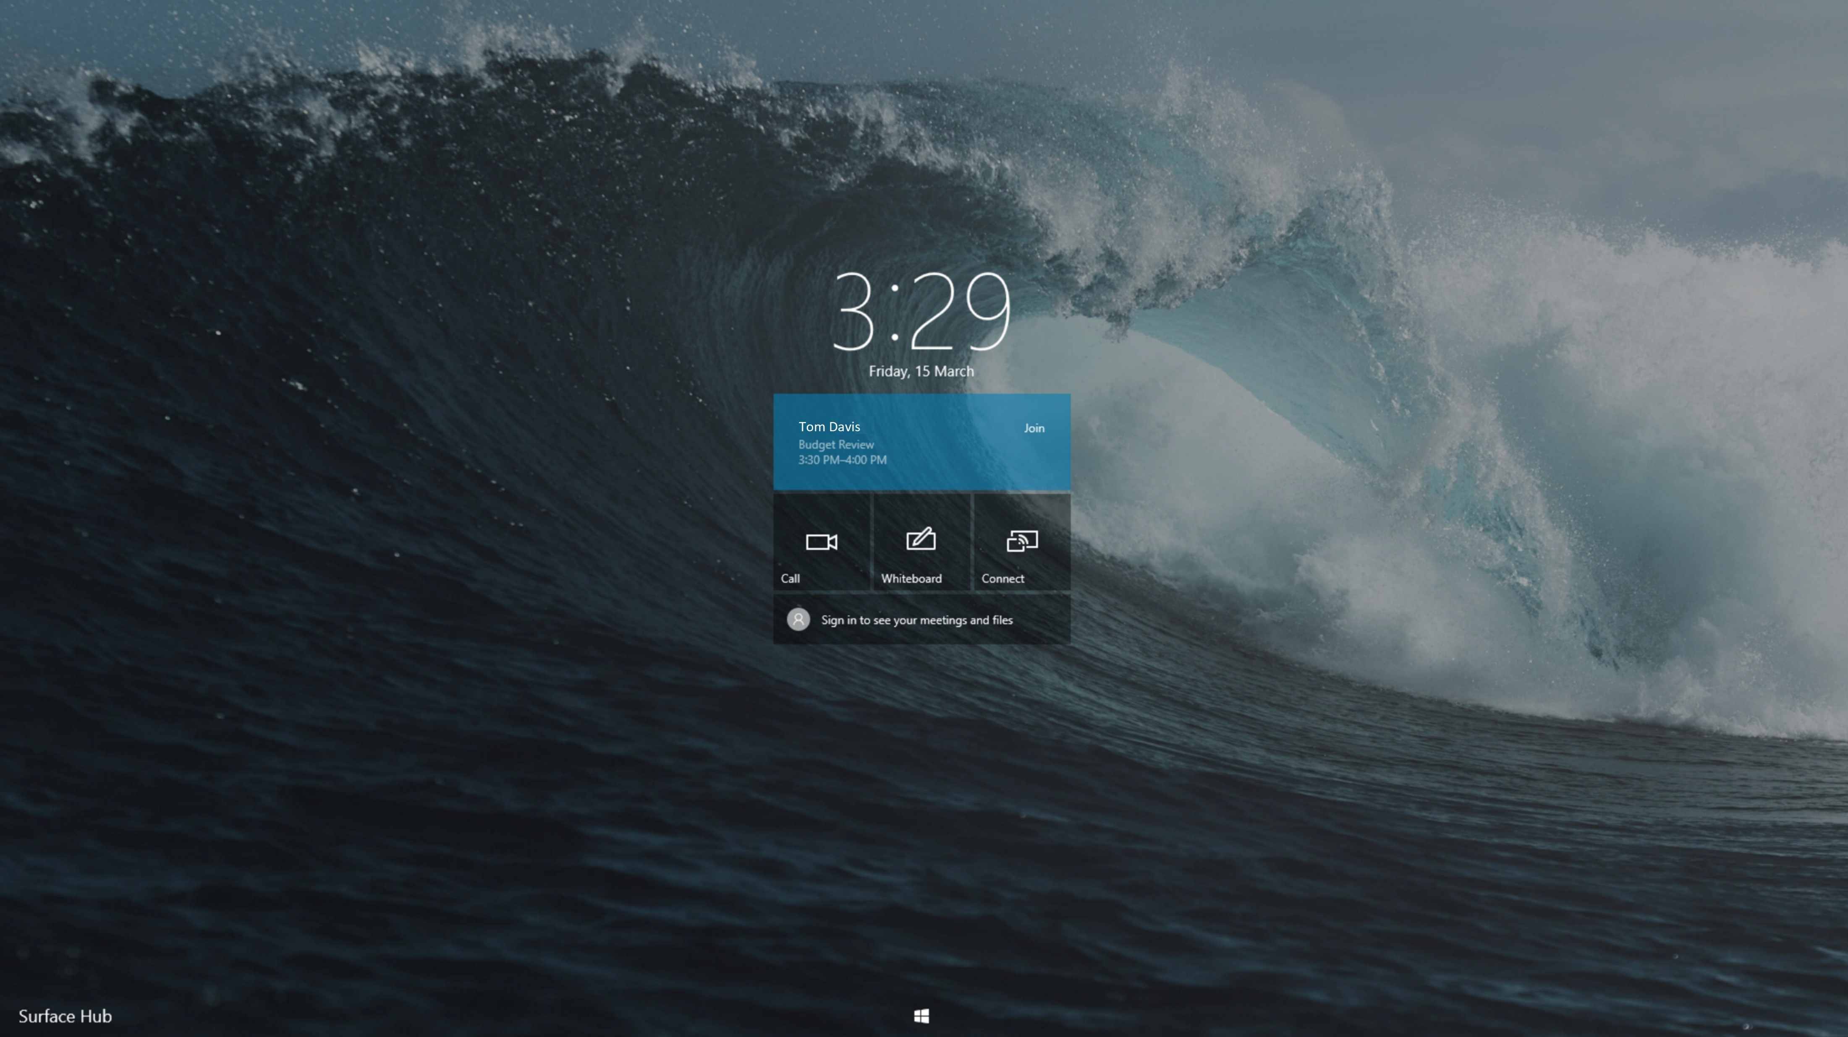








<- Back to Table of Contents

Slide 4
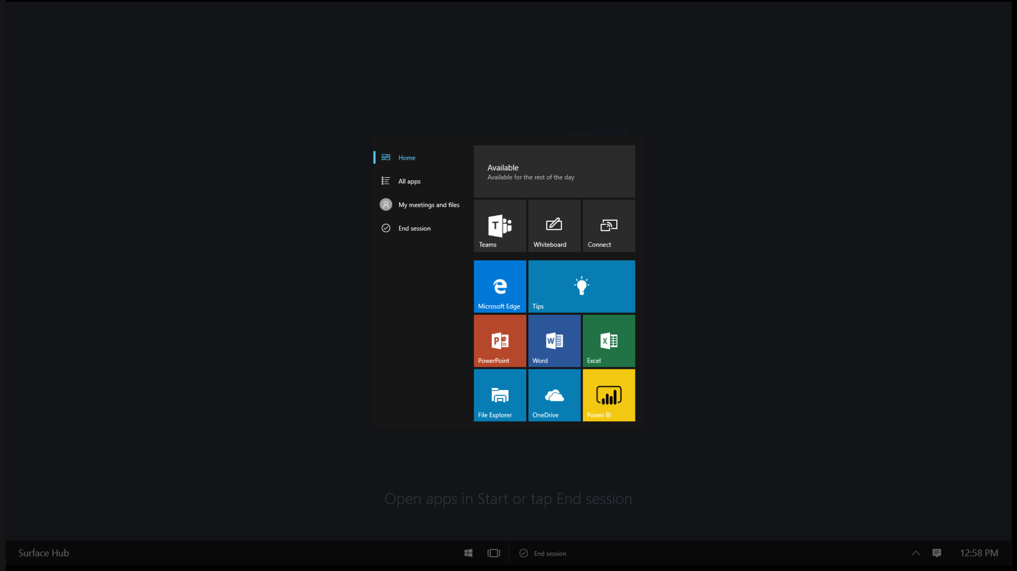

<- Back to Table of Contents

Slide 5
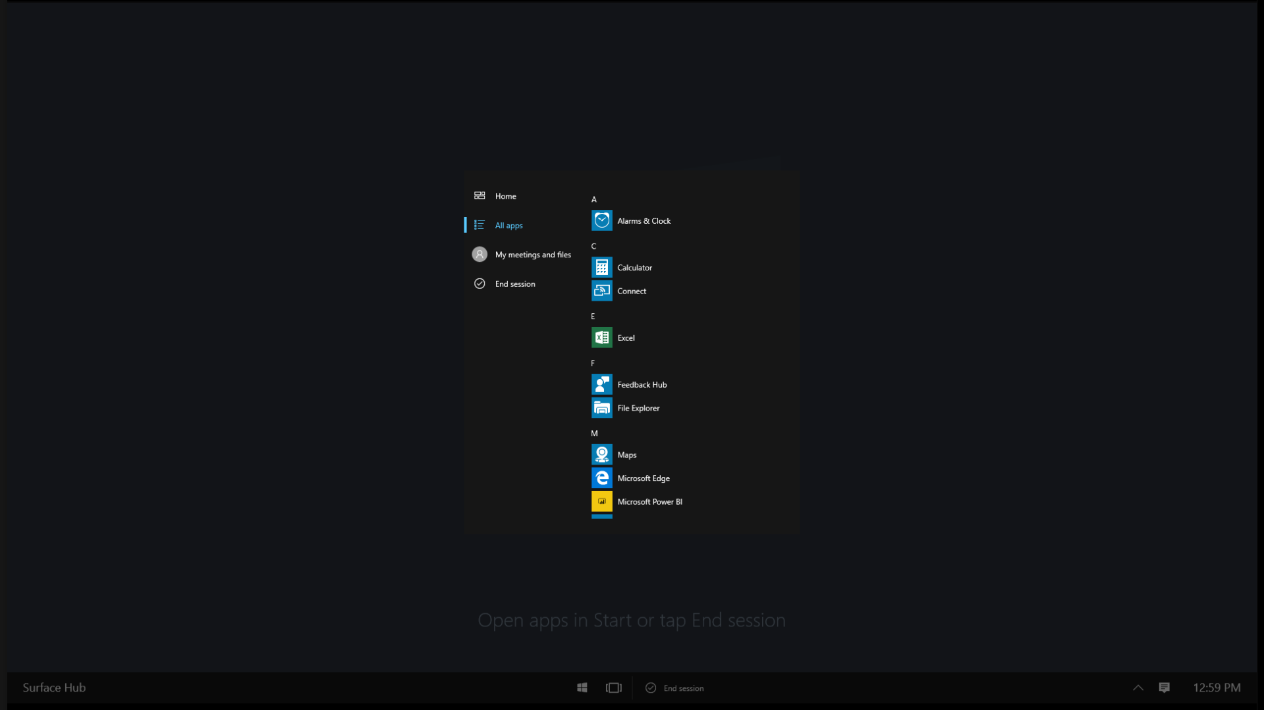

<- Back to Table of Contents

Slide 6
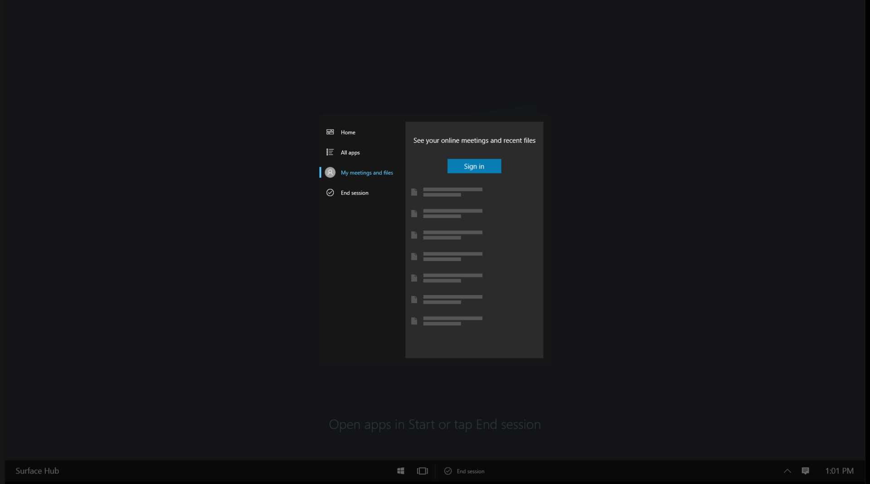

<- Back to Table of Contents

Slide 7
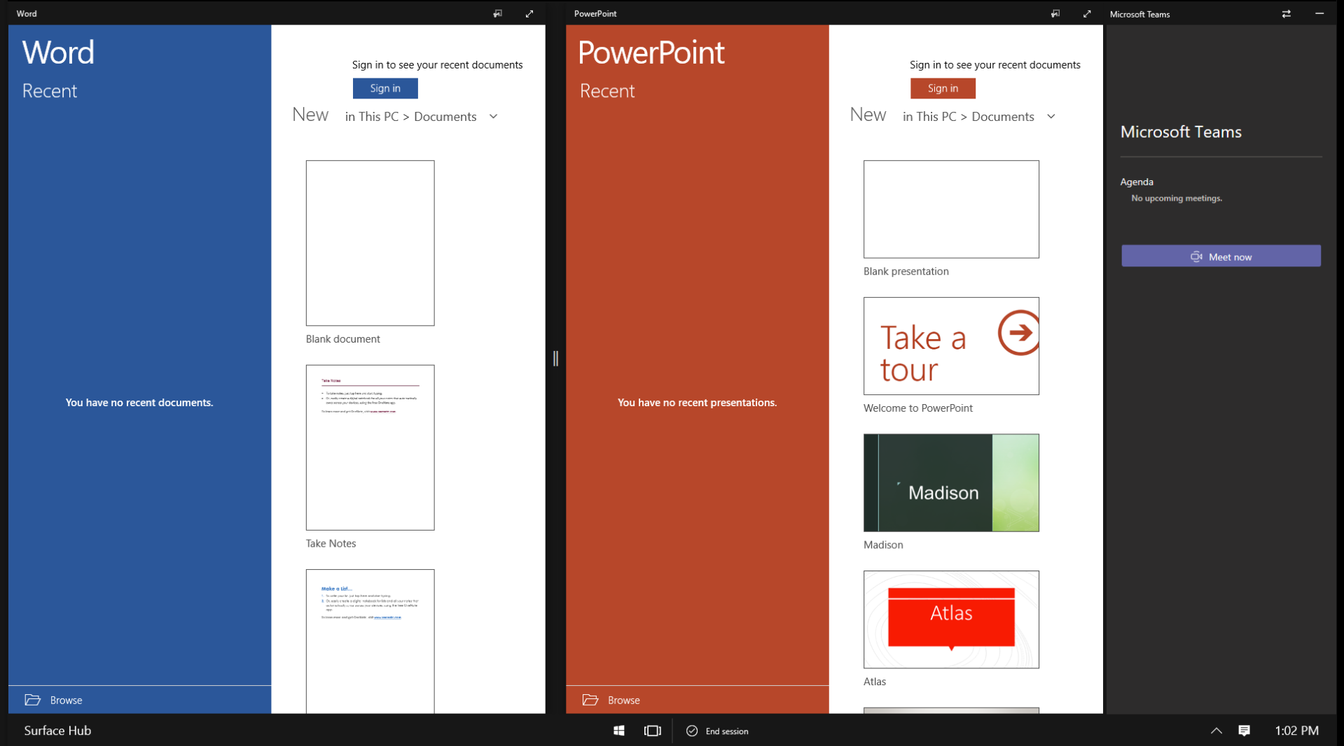










<- Back to Table of Contents

Slide 8




<- Back to Table of Contents

Slide 9
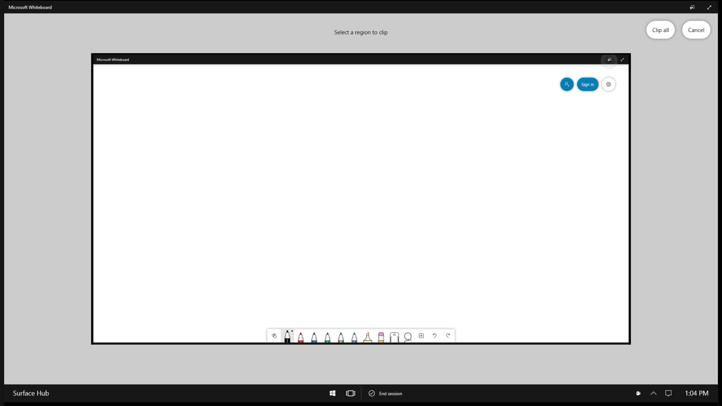

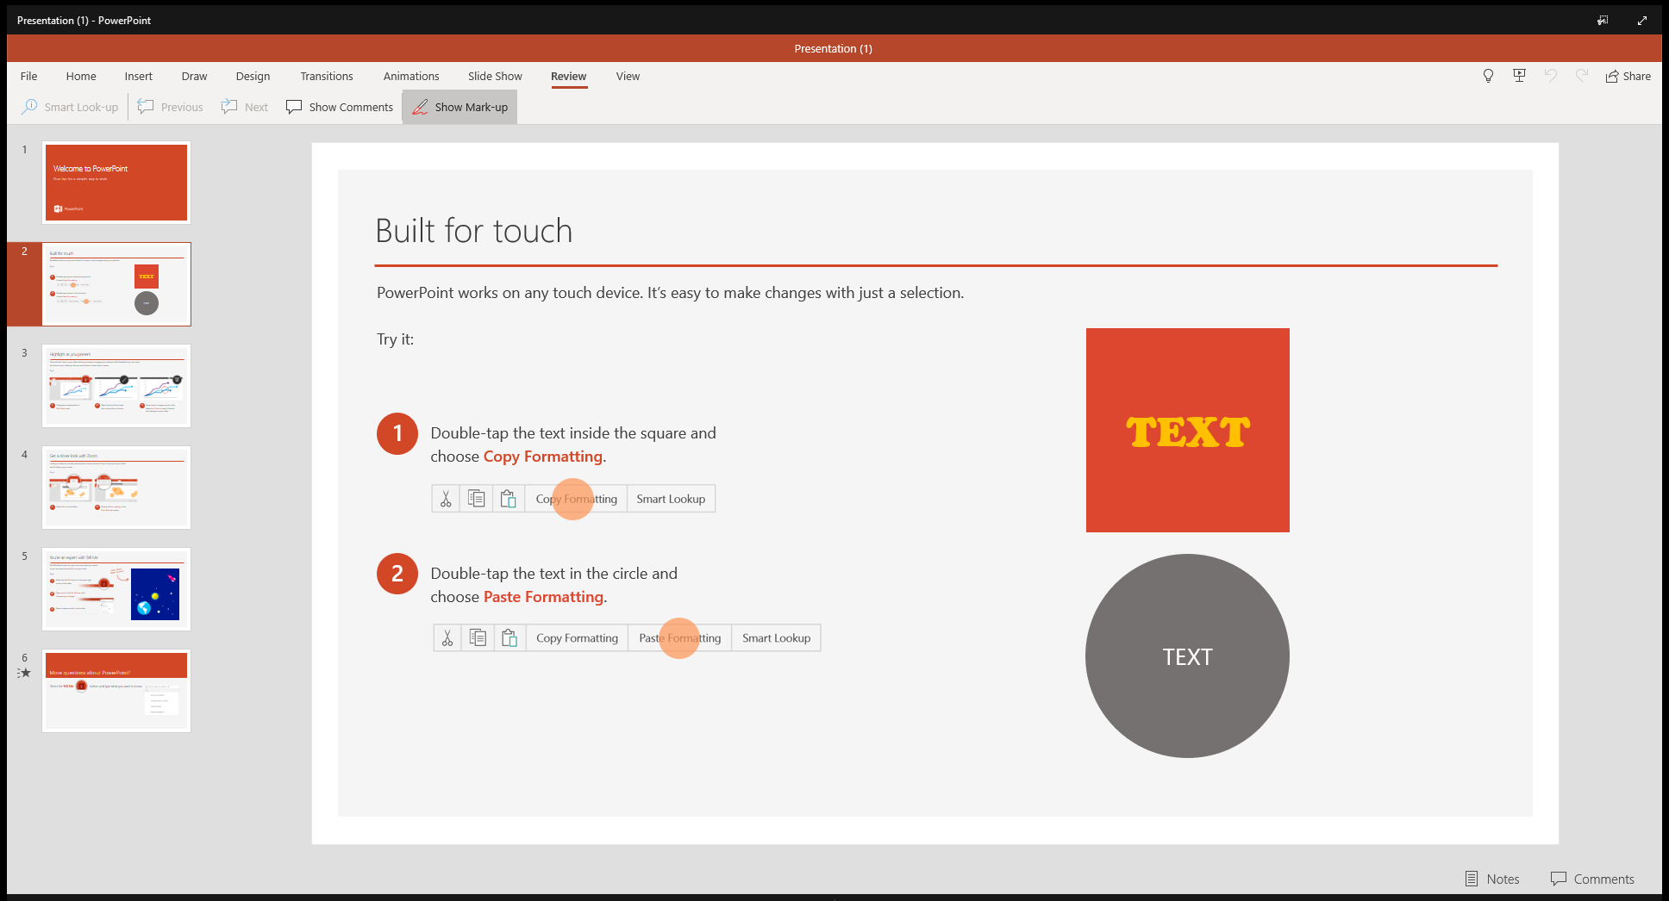



<- Back to Table of Contents

Slide 10
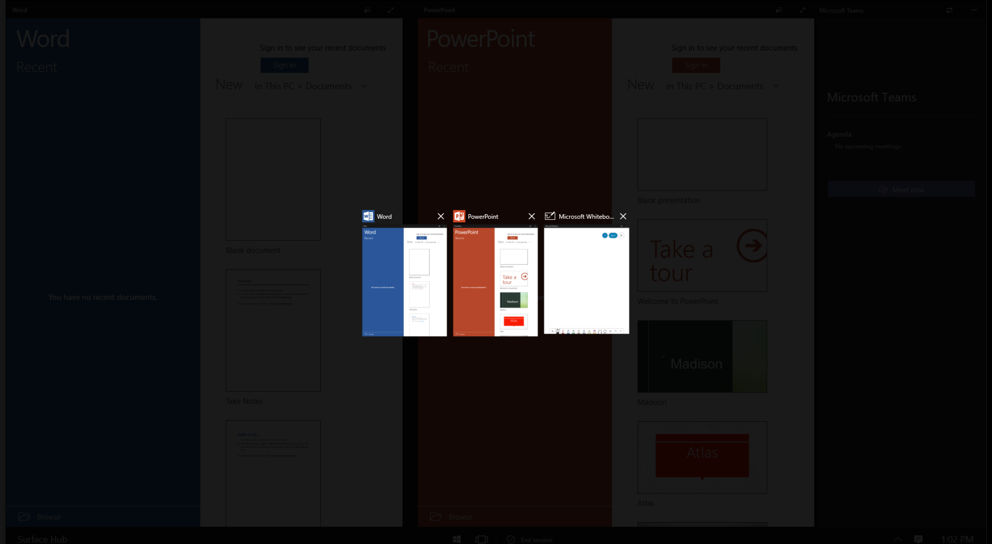


<- Back to Table of Contents

Slide 11
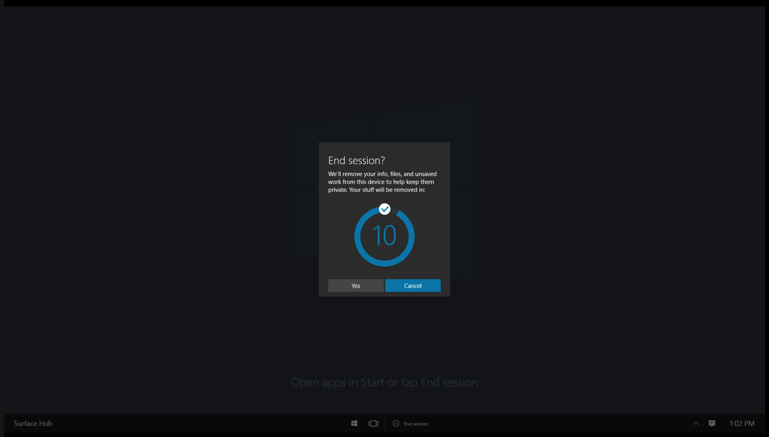

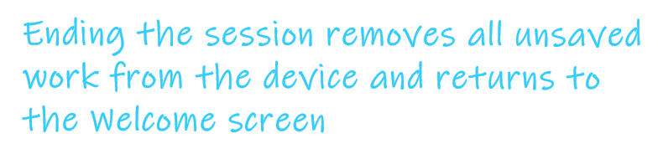


<- Back to Table of Contents

Slide 12
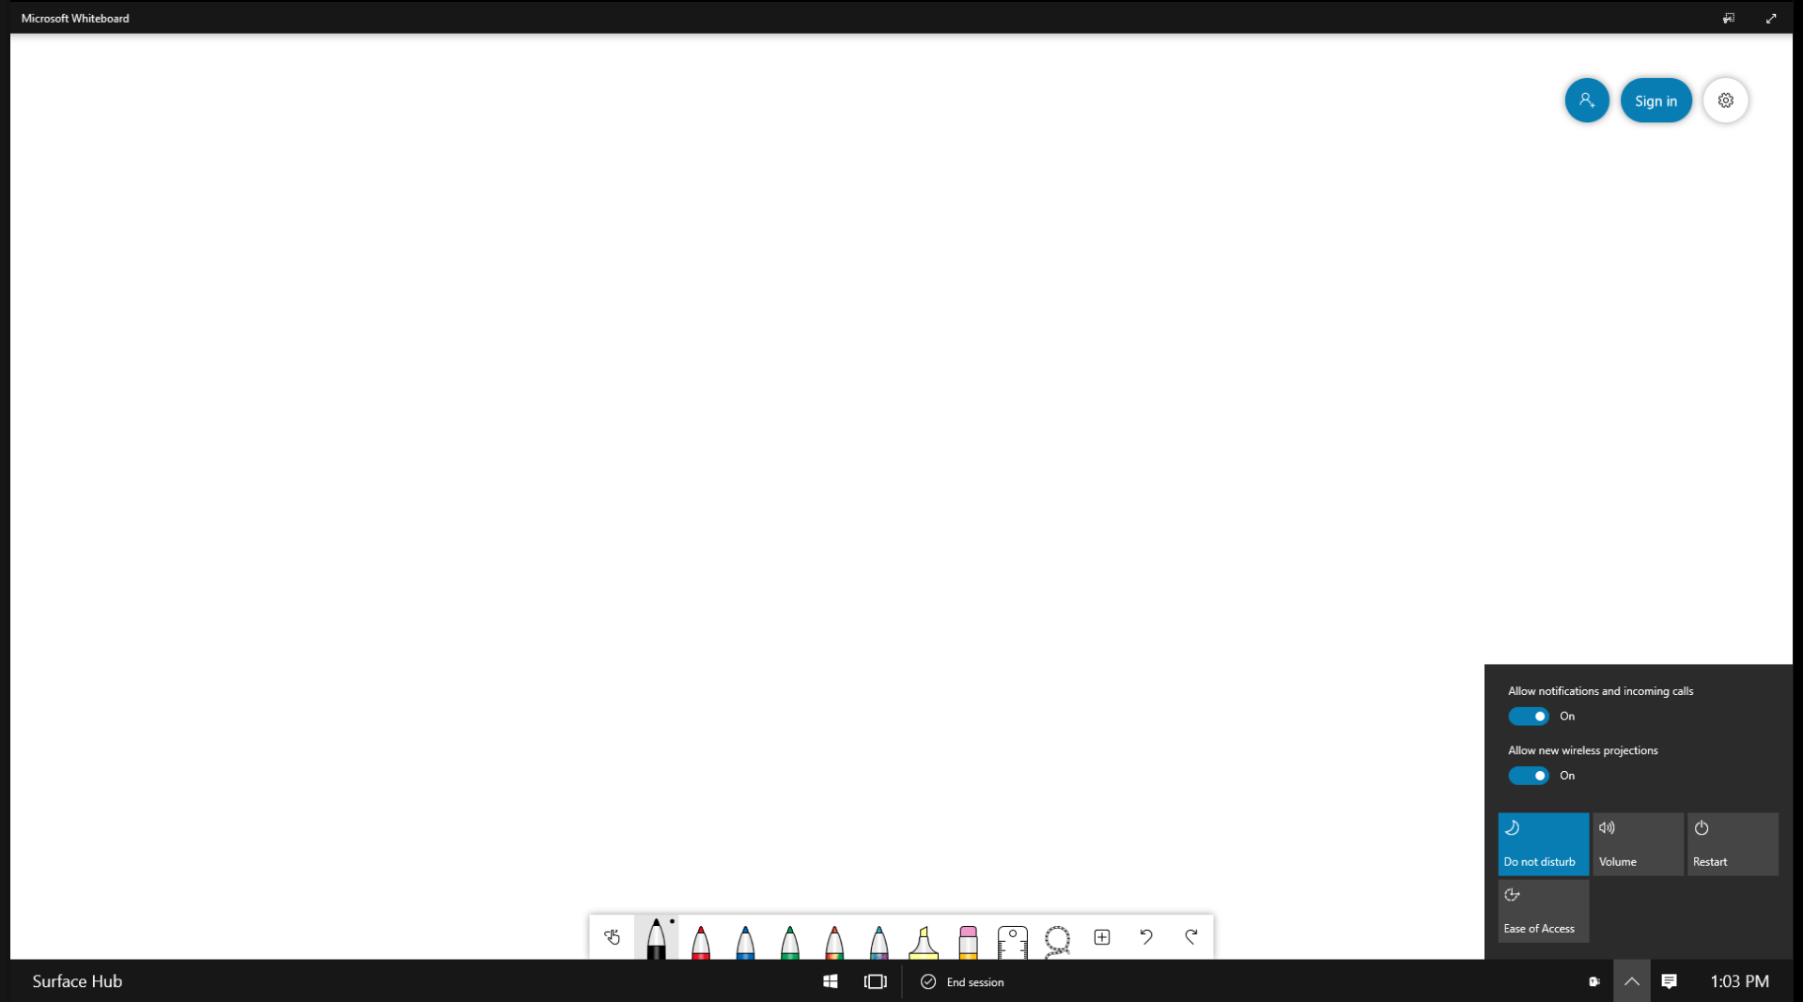


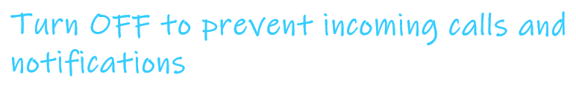

<- Back to Table of Contents

Slide 13
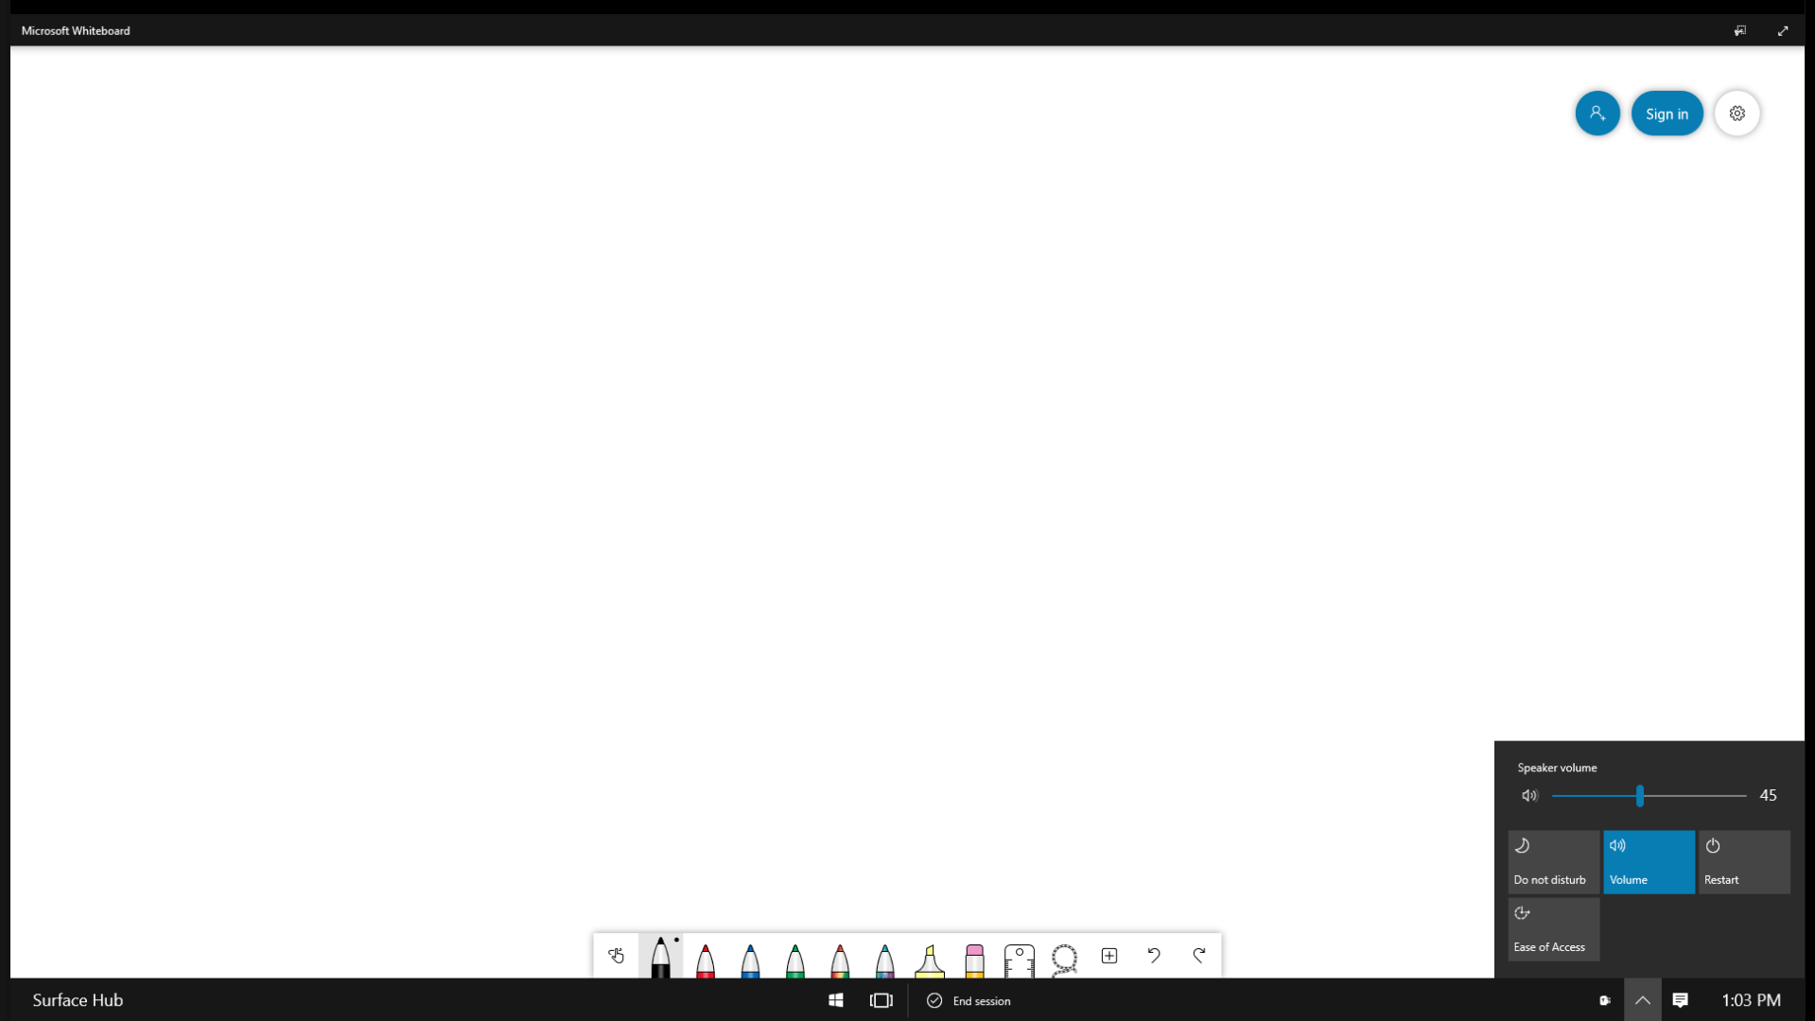


<- Back to Table of Contents

Slide 14



<- Back to Table of Contents

Slide 15
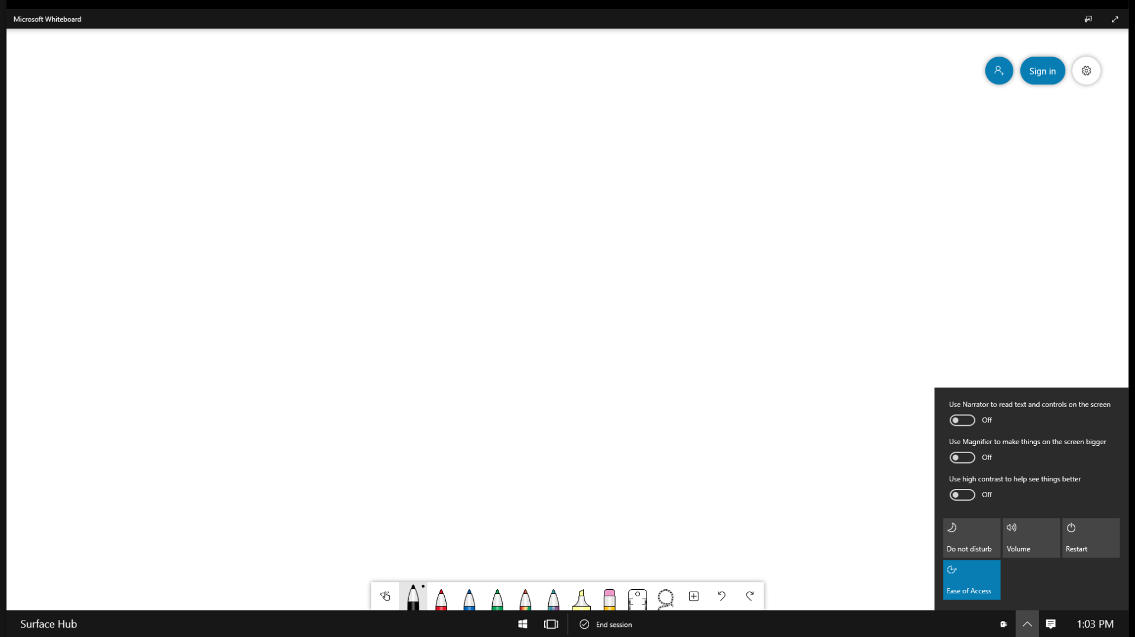




<- Back to Table of Contents

Slide 16
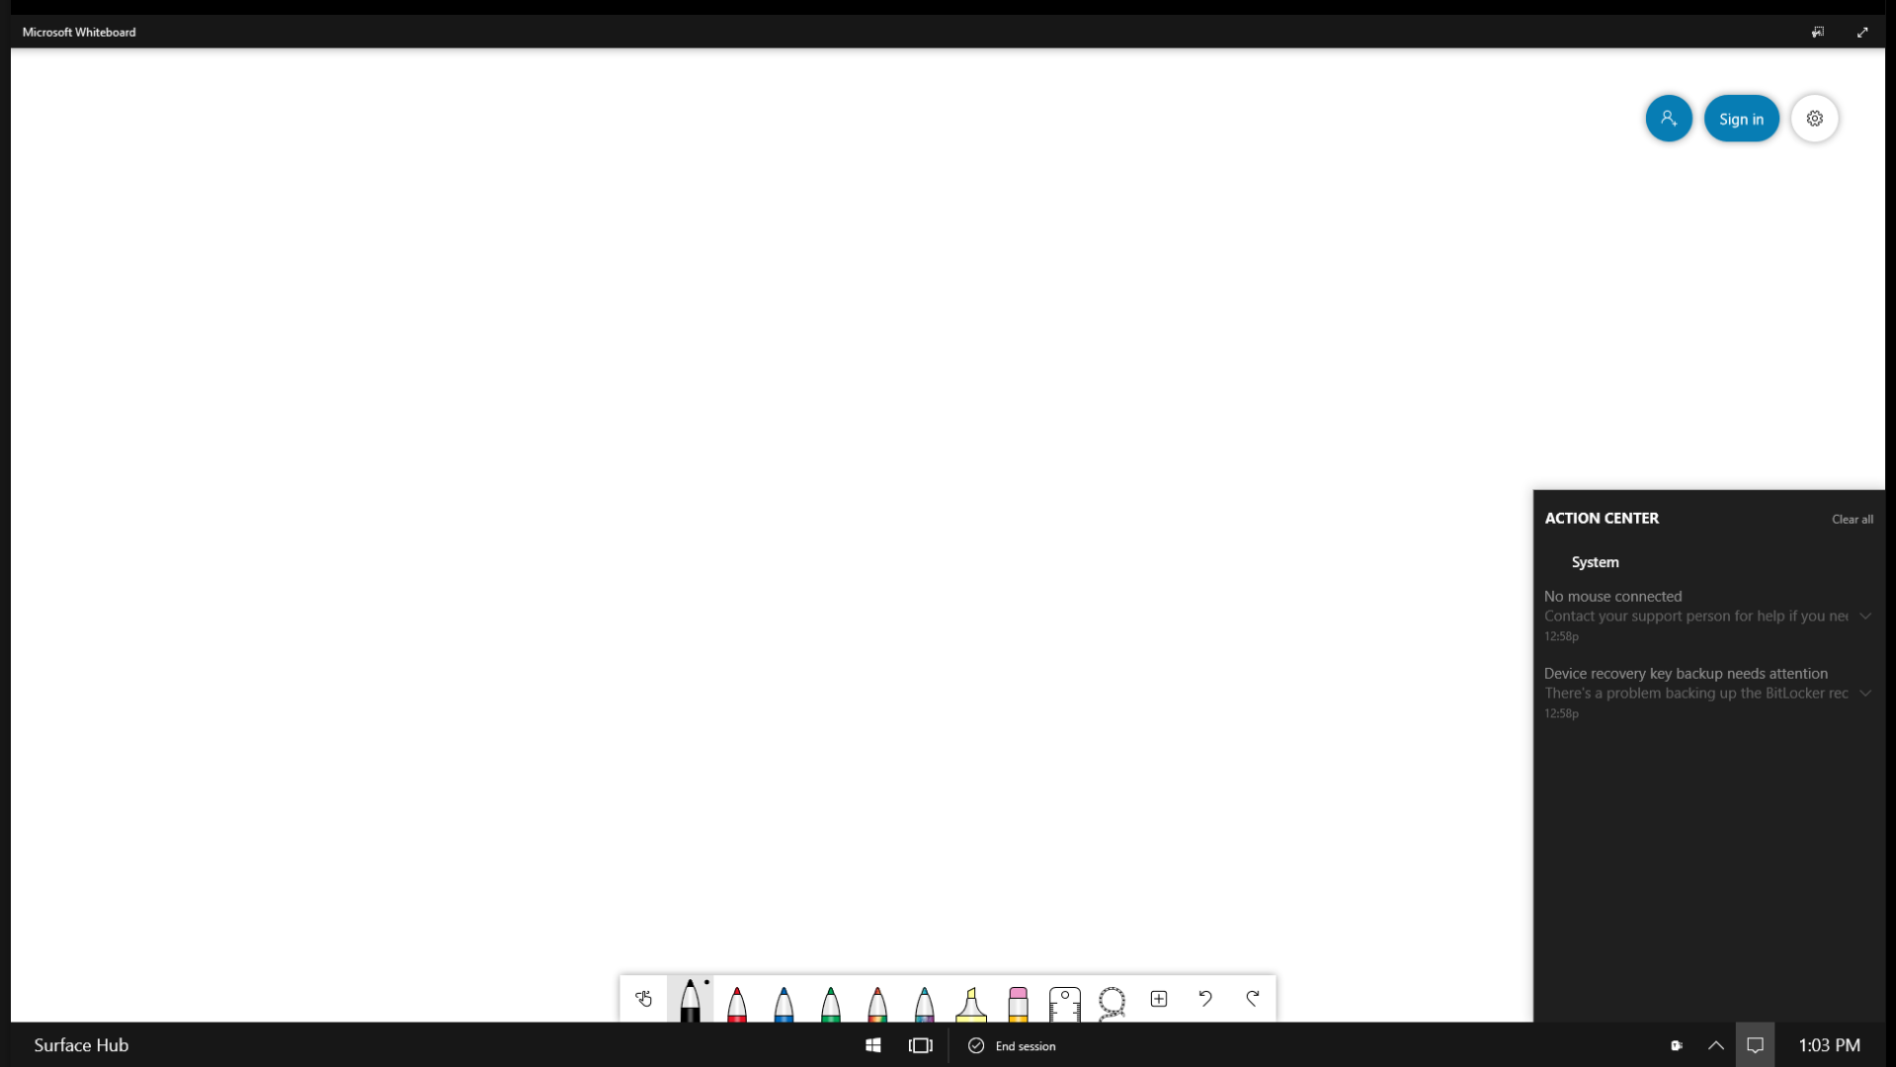

<- Back to Table of Contents

Slide 17
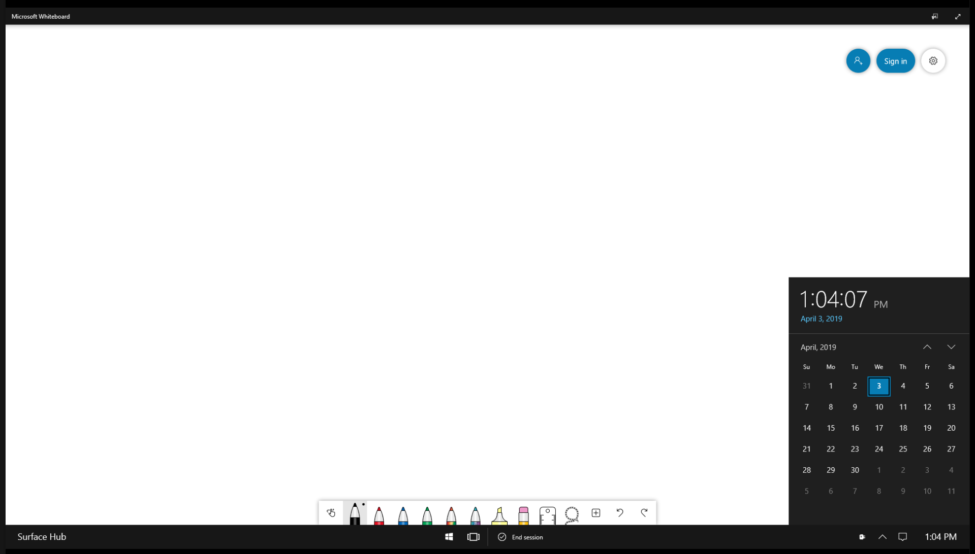

<- Back to Table of Contents

